Slide 1
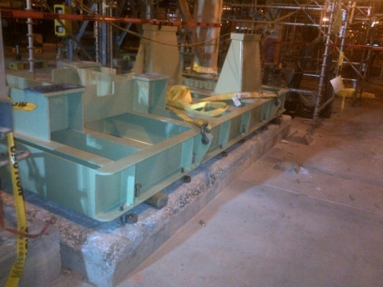
HS&E INCIDENT BULLETIN |  | 1st half year 2014
U.S. | Type of incident Material Handling
Summary:
While setting a pump onto foundation anchor bolts, an employee used a “hockey puck” (field term) to tap the anchor bolt into place underneath the pump that was not lining up. When the anchor bolt moved and aligned with the hole, the pump cleared all jack bolts and the pump skid (11,000 lbs. / 5,000 kg) fell onto the employee’s arm.
Root Causes: | Actions Taken Thus Far: Next Steps
Lead men failed to stop work and escalate to the site contact for mitigation when scaffolding above did not allow for optimal rigging configuration. | Conduct refresher training on standard work, risk assessment and hazards, JSEA use and Life Safety Rules. Conduct cultural assessment, share the results and take appropriate action. Develop a field service safety committee. Ensure leadership visibility at field service jobs.

